Slide 1

Instructions for Accessing Required Online Testing

Slide 2
Effective February 1st, 2026 all non-classroom tests (formerly referred to as “paper-based” tests) will only be available to be completed online. No paper-based test proofs will be accepted past February 1st, 2026.
Go to CEI’s main webpage to access Training PowerPoints https://www.ceicmh.org/for-providers/training.html, and scroll down to the “Required Trainings” table. Review the training material by clicking on the “Training” link next to the associated training title. Then go back to the table and click on “Test” to complete the test on the CEI’s Classroom Clipboard page. Be sure to refer to your contract’s required training grid to see what training tests you must take as some of the listed trainings on the below grid may not be required for your position. You can find training grids on our main website here or refer to your manager/contract’s attachments.
Be sure to discard any old paper-based training PowerPoints you have printed as they are updated every October.

Slide 3
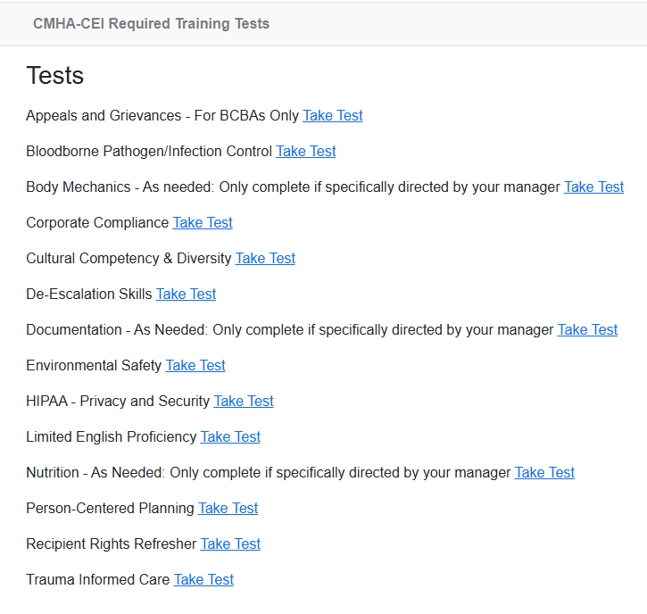
There is no cost to complete the trainings online and you do not need individual logins or accounts to access and complete the tests.
Once you are have reviewed the training PowerPoints located on CEI’s website https://www.ceicmh.org/for-providers/training.html, click on the “Test” link to complete the associated test.
Here is CEI’s Classroom Clipboard page if you want to save the address: https://www.classroomclipboard.com/986819
To the right is a screenshot of what this will look like.
Please ensure you know which trainings to take by contacting your manager. Not everyone has to take each of these trainings.
To take a test, click on the “Take Test” link for each training.

Slide 4
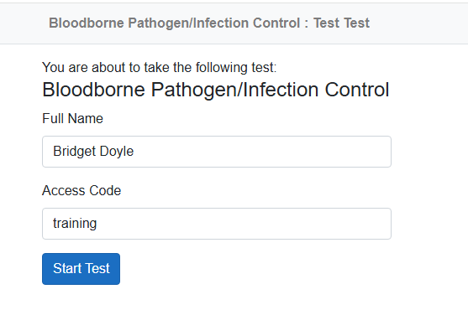
After clicking on the “Take Test” link, you will need to enter your name and an Access Code
The Access Code for EVERY test is: training (all lowercase):

Slide 5
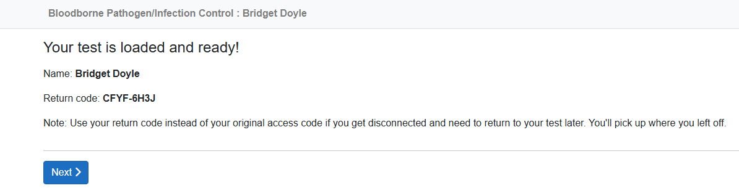
After entering your name and the access code and clicking Start Test you will see this screen:
You will see a “Return Code” make sure to write this down in case you get disconnected or if you need to stop the test and return later. This Return Code will allow you to pick up where you left off.
If you do not write this down and leave the website before completing the training, you will have to start the test from the beginning.

Slide 6
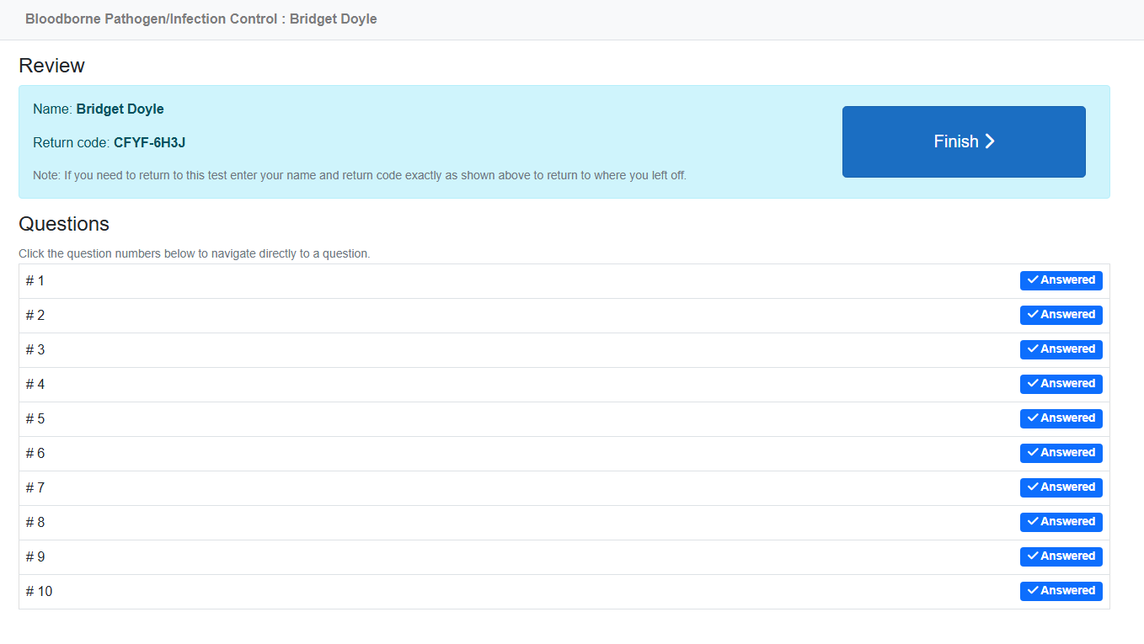
The passing score for each test is 80%.
You have unlimited attempts to pass each test by at least 80%.
After you have answered all the questions you will see this “Review” screen with your answers. You can go back and review each question by clicking on “Answered”.
Click on “Finish” to submit your answers.

Slide 7
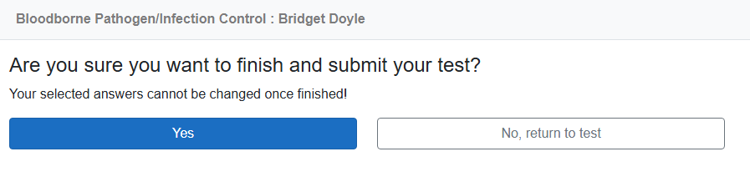
After clicking Finish, you will have one last opportunity to review the test. When ready, click on Yes.

Slide 8
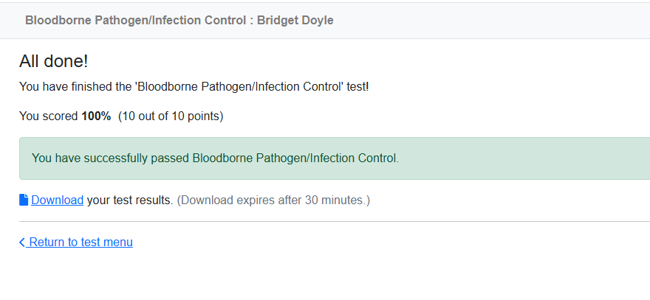
After you have submitted your test, you will see this screen which gives you your score. Remember you must retake the test if you score below 80%.
IMPORTANT! Click on the “Download” button to download your test results. This download is your proof of completion – you need to SAVE THIS and send it to your Manager. This website does not save any records of training.

Slide 9
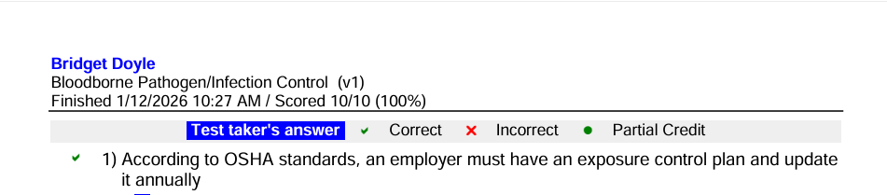
After clicking on “Download your test results” you will get a PDF of the test which will show your name, the name of the test, your grade, and the date you took the test.
This is your record of completing your required trainings. You can print this or download it. You will need to do this for each test you complete every year. Be sure to provide a copy to your manager.

Slide 10
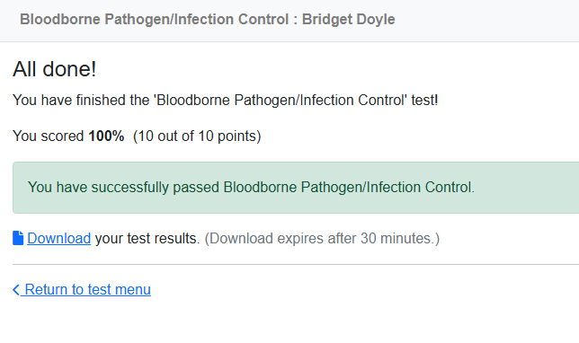
After you have finished and downloaded your results, you can click on “Return to Test Menu” to complete any additional tests needed.
Please check with your manager if you are unsure of which tests you need to complete.
If you have questions, please contact the Training Unit: training@ceicmh.org or Quality Advisors: QCSRR-QA@ceicmh.org

